Slide 1
MicroServices

Slide 2
A Service
One and only capability
Single responsibility
Narrowly scoped
Exposed through API or well defined endpoint
Example: Managing a warehouse

Slide 3
A service
Runs in a separate process
Written and Deployed independently
No dependence on other services
Has its own dedicated data store
However, it communicates and collobrates with other services to complete its action.

Slide 4
Services can
Choose their language
Choose their platform
Choose the communication stack

Slide 5
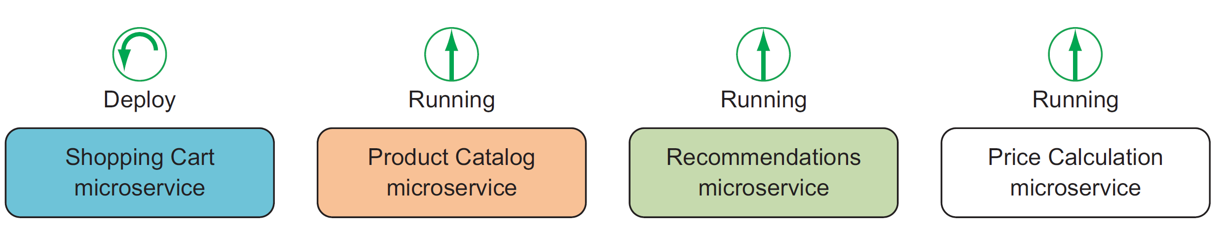

Slide 6
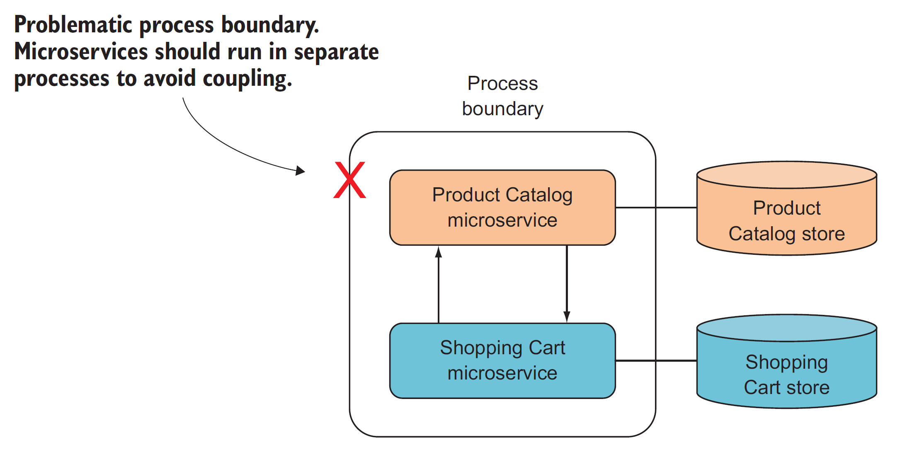

Slide 7
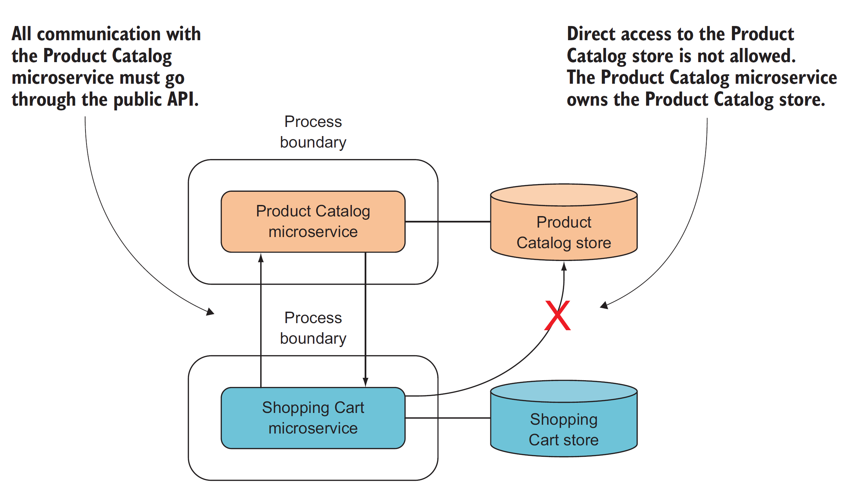

Slide 8
Why ???
Enables Continuous Delivery
can be developed and modified quickly
can be comrehensively tested by automated tools
can be deployed independently
can be operated efficiently

Slide 9
Overheads
MicroServices are distributed systems. They are typically more complex and need more configuration. The cost for distributed systems is typically more than non-distributed systems
Comprises of multiple services. Each needs to be developed, deployed and operated on production.There will be considerable more deployments and complex production setup. There will be lot more moving pieces comparatively.
Generally separate codebase and so difficult to refactor

Slide 10
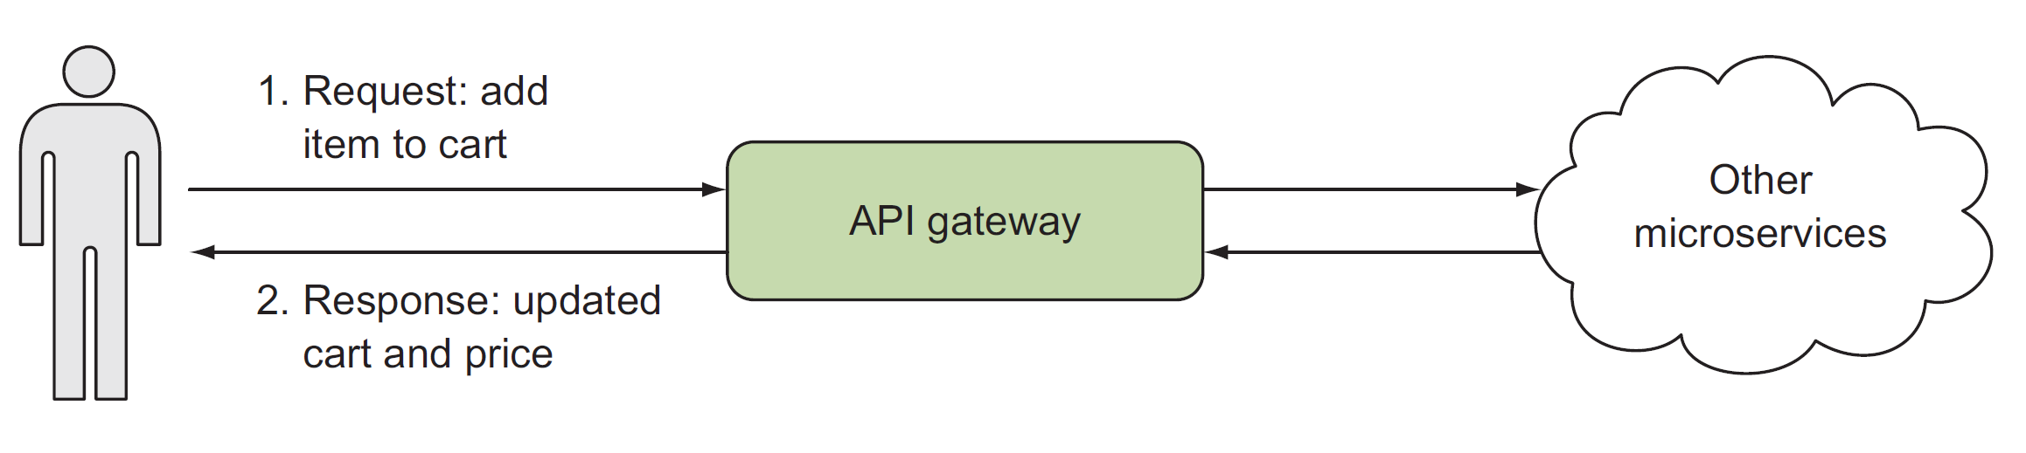

Slide 11
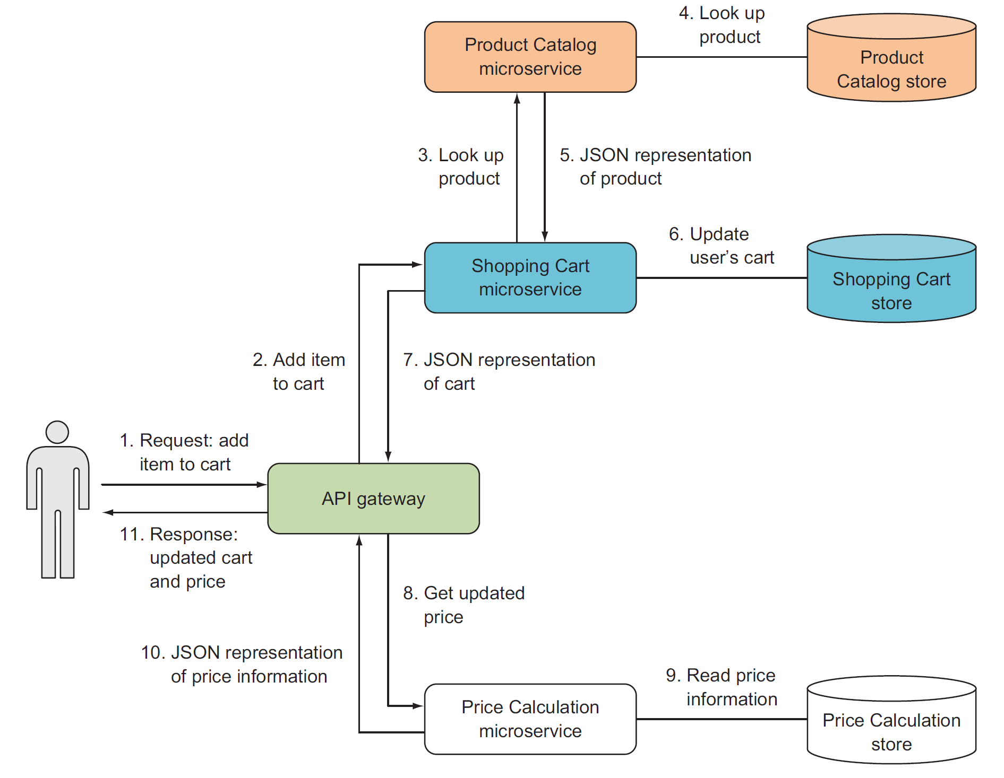

Slide 12
Technology Stack
Can be very diverse
Serverless Microservices using Azure functions
Services deployed in containers on virtual machines
Services deployed in containers in web apps/ functions etc
Any combination above
Any language
Any platform

Slide 13
Low level details
ASP.NET Core
Asp.NET Core MVC API
Docker containers on virtual machines
SQL Server in containers and Azure SQL
Docker compose
VSTS for Build and Release

Slide 14
Domain Driven Design

Slide 15

Focus on Design ??

Slide 16
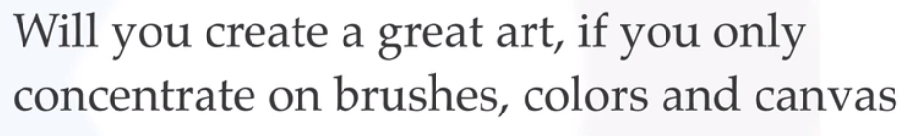
Help me answer few questions

Slide 17
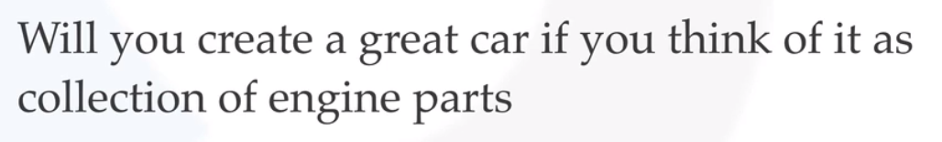

Slide 18
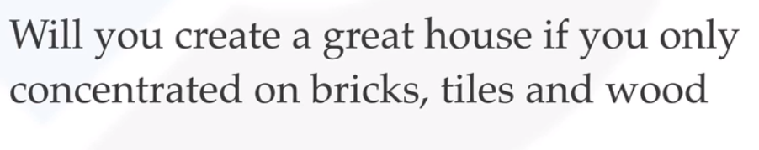

Slide 19
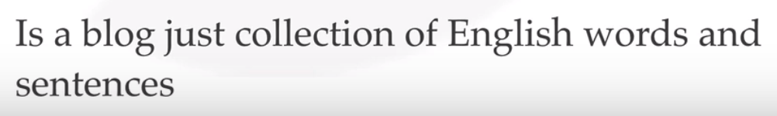

Slide 20
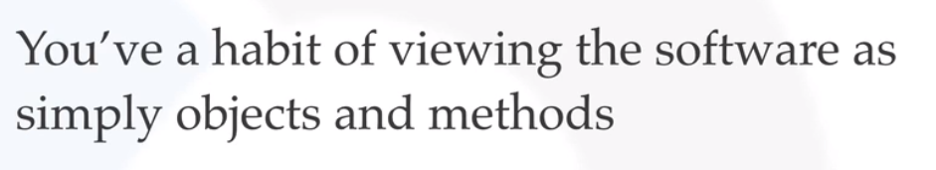

Slide 21
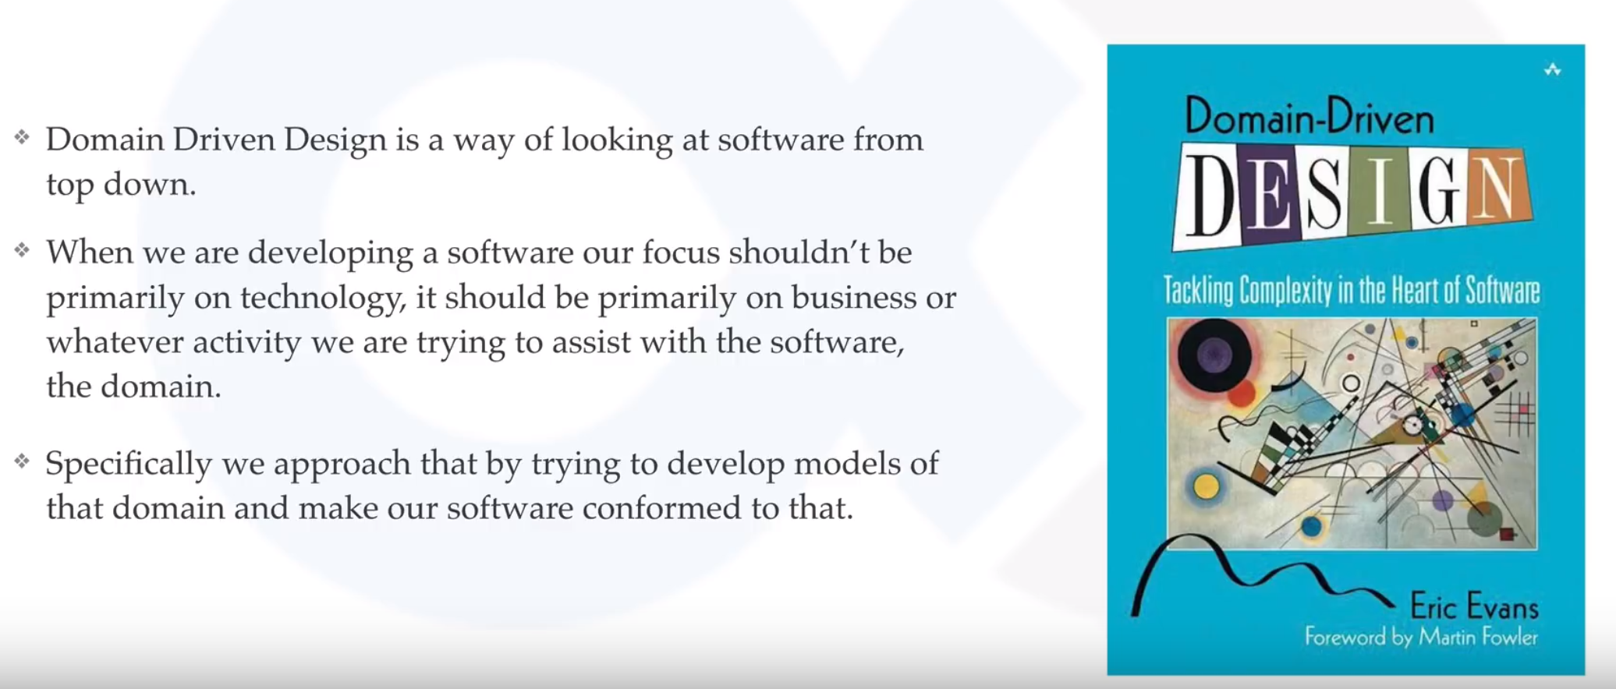

Slide 22
Tactical Design
Service
Project
Strategic Design
Layers
Domain
Modules
Patterns
Sub-Domain
Sub-Domain
Sub-Domain
OOPS
Service
Service
Service
Classes
Objects
Executable

Slide 23
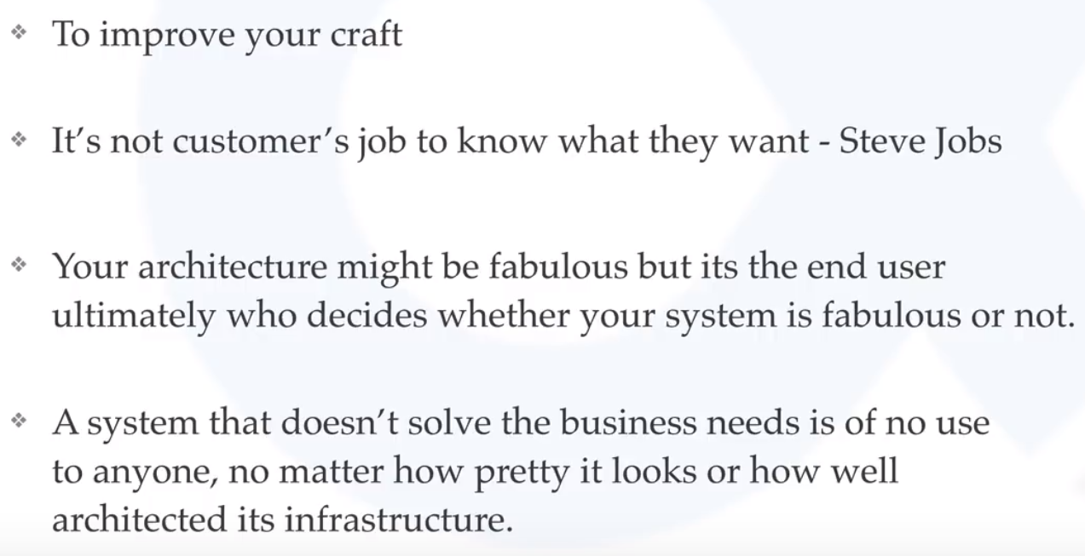

Slide 24
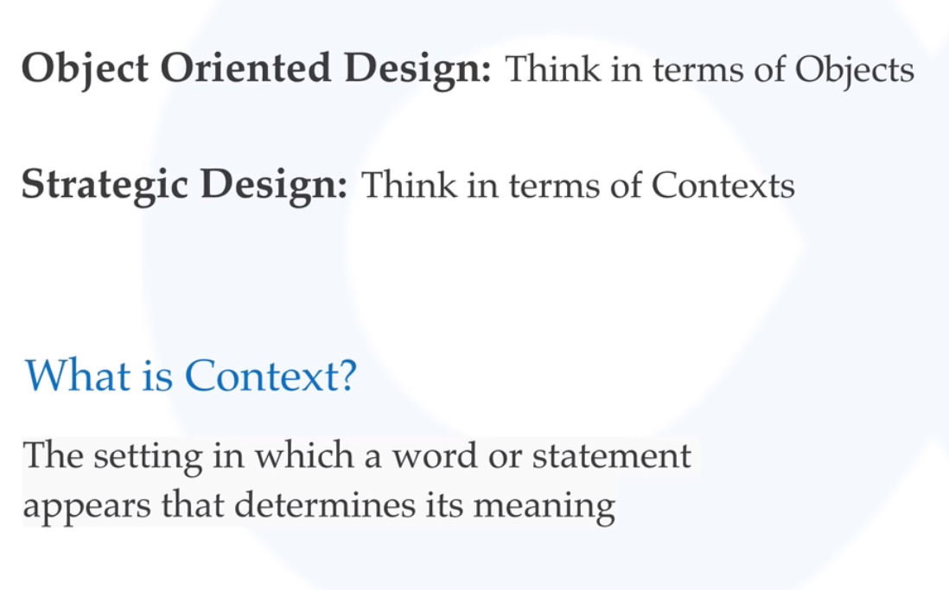
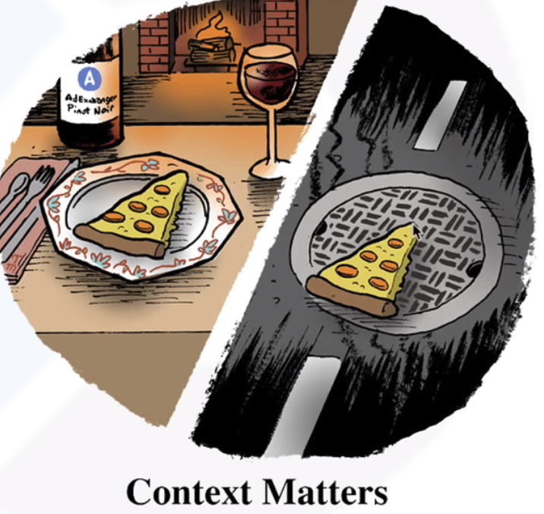
Strategic Design

Slide 25
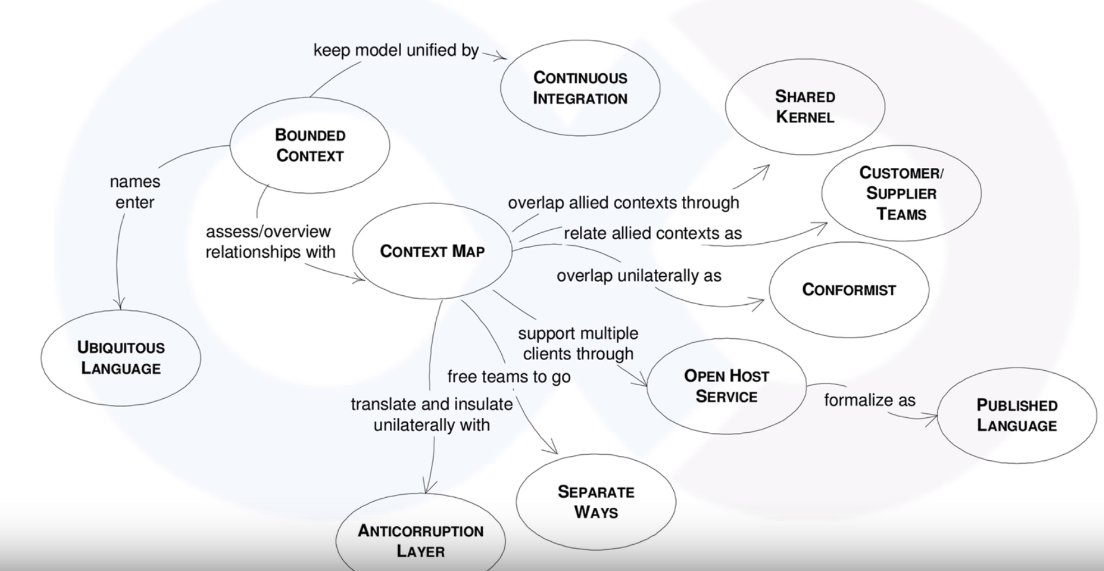

Slide 26
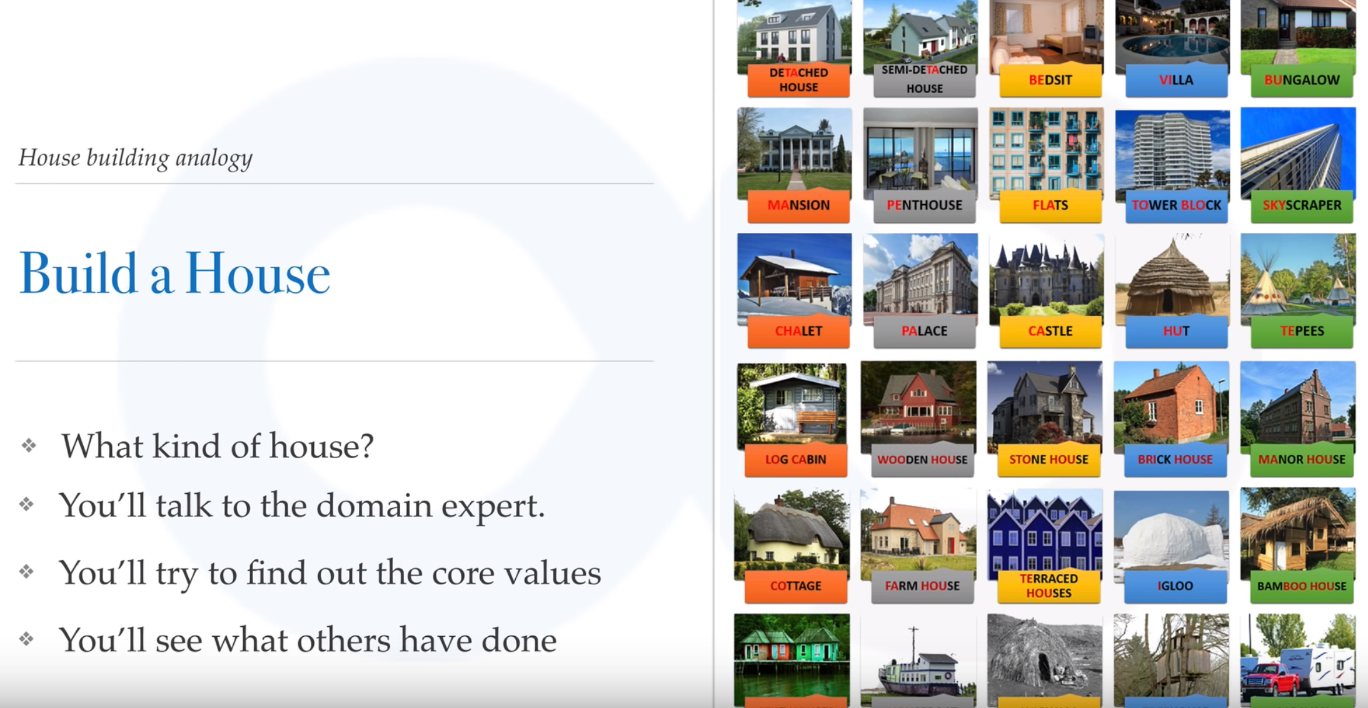

Slide 27
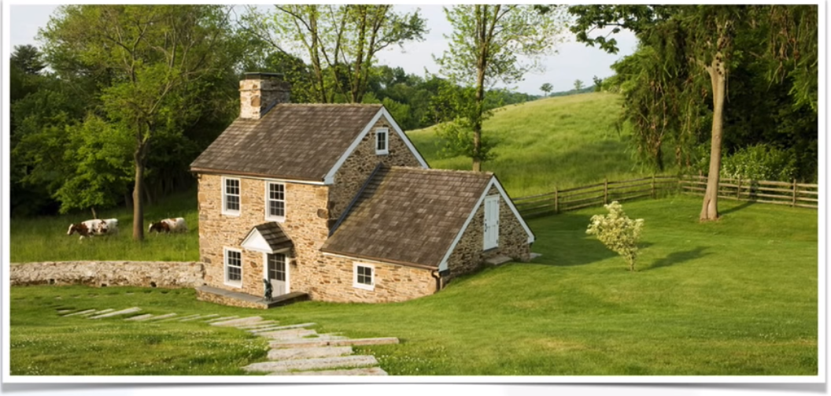
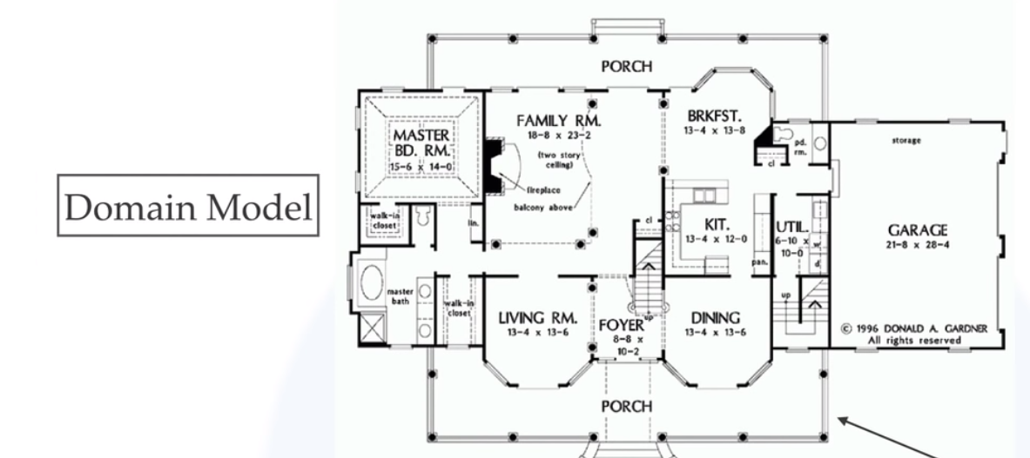
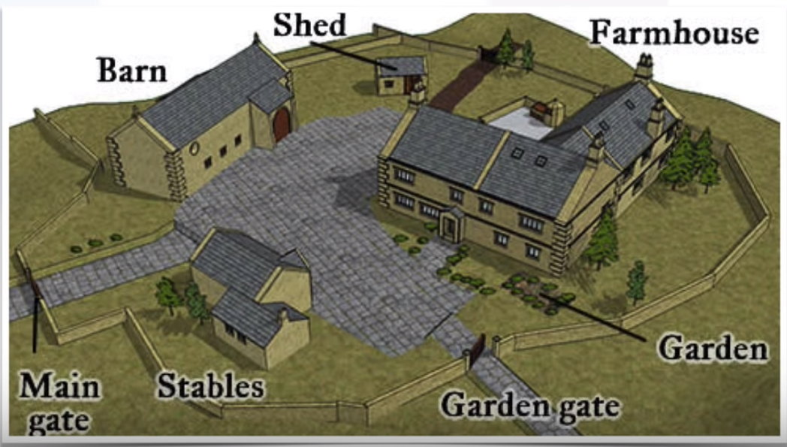

Slide 28
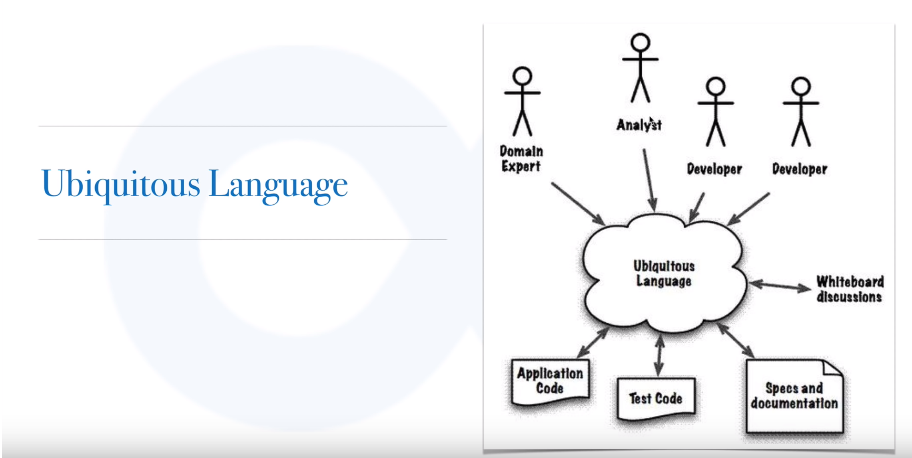

Slide 29
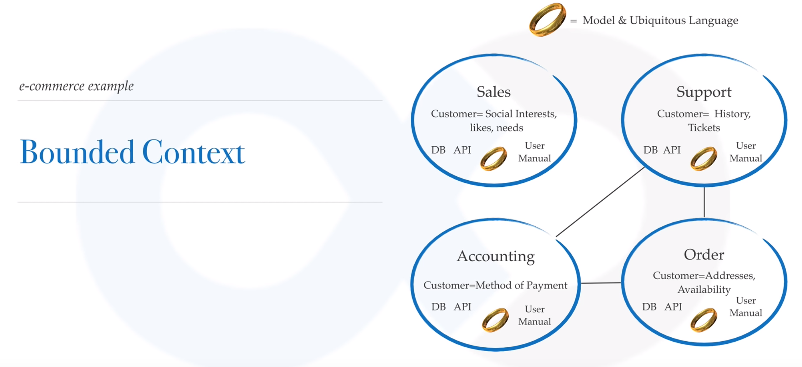

Slide 30
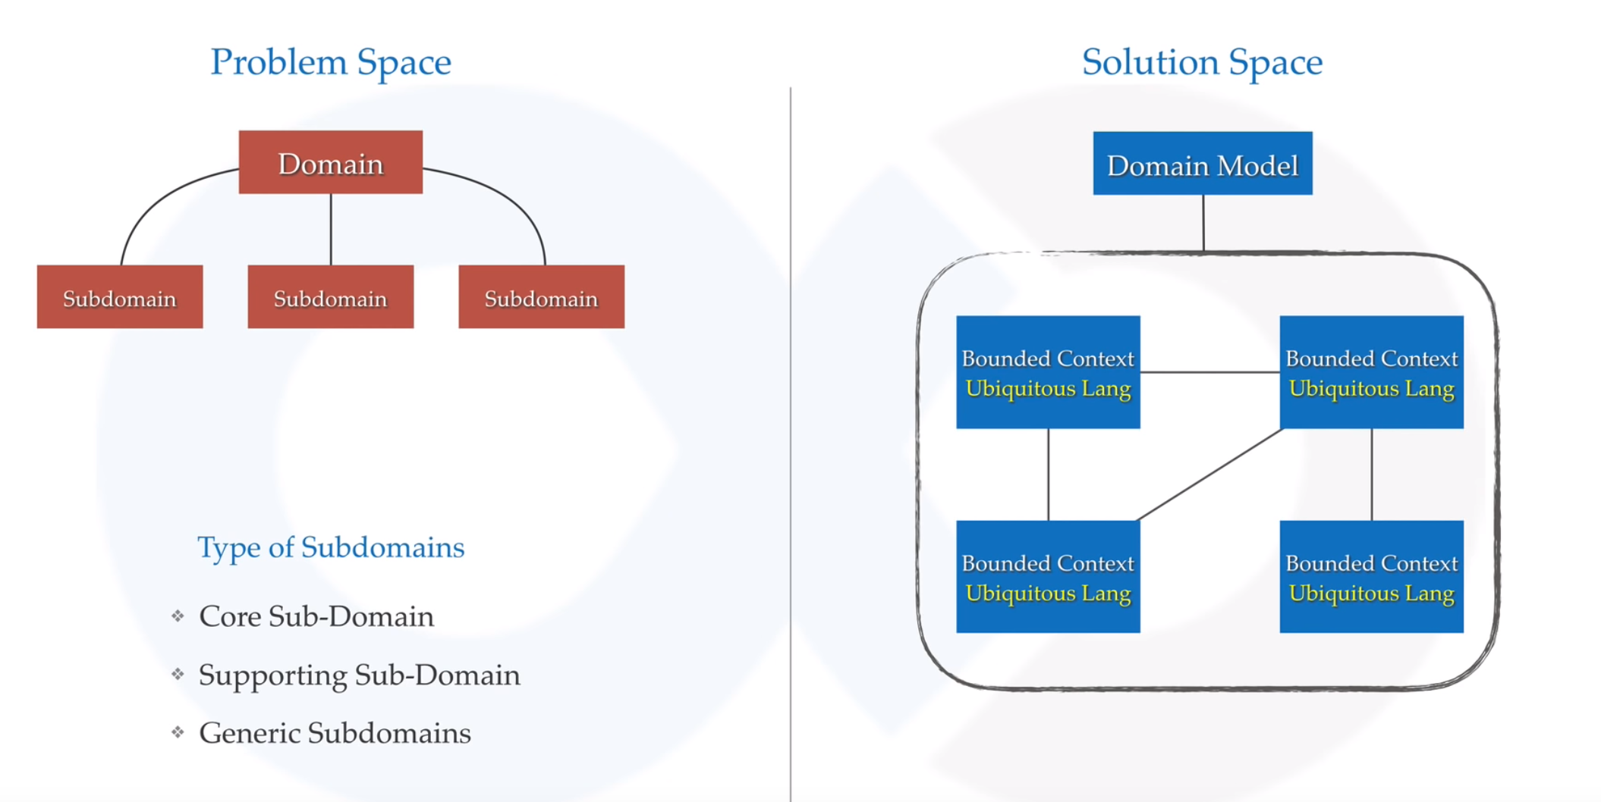

Slide 31
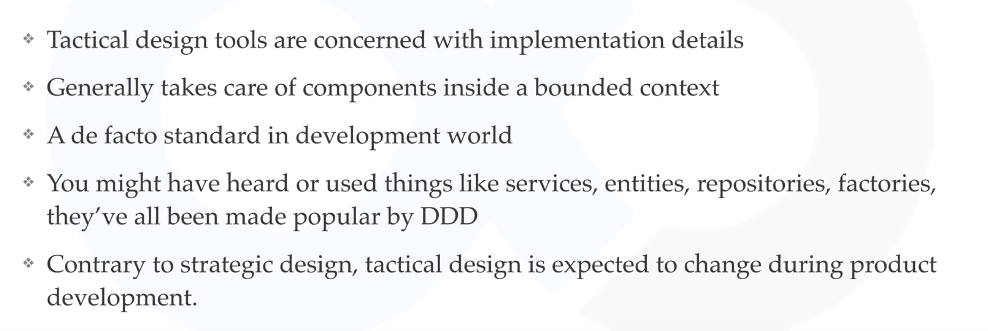

Slide 32
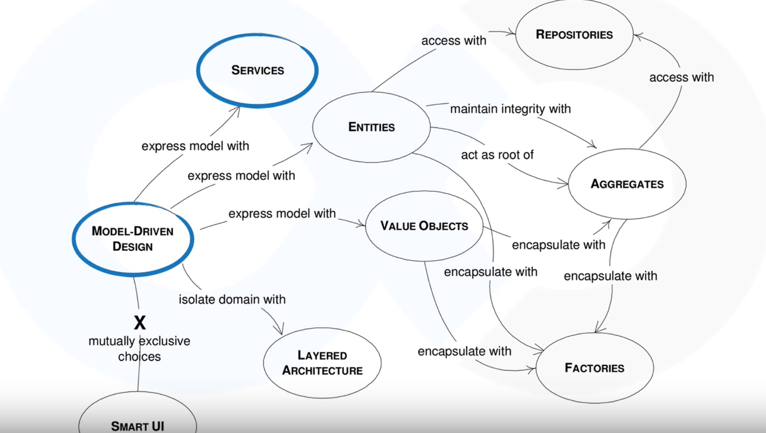

Slide 33
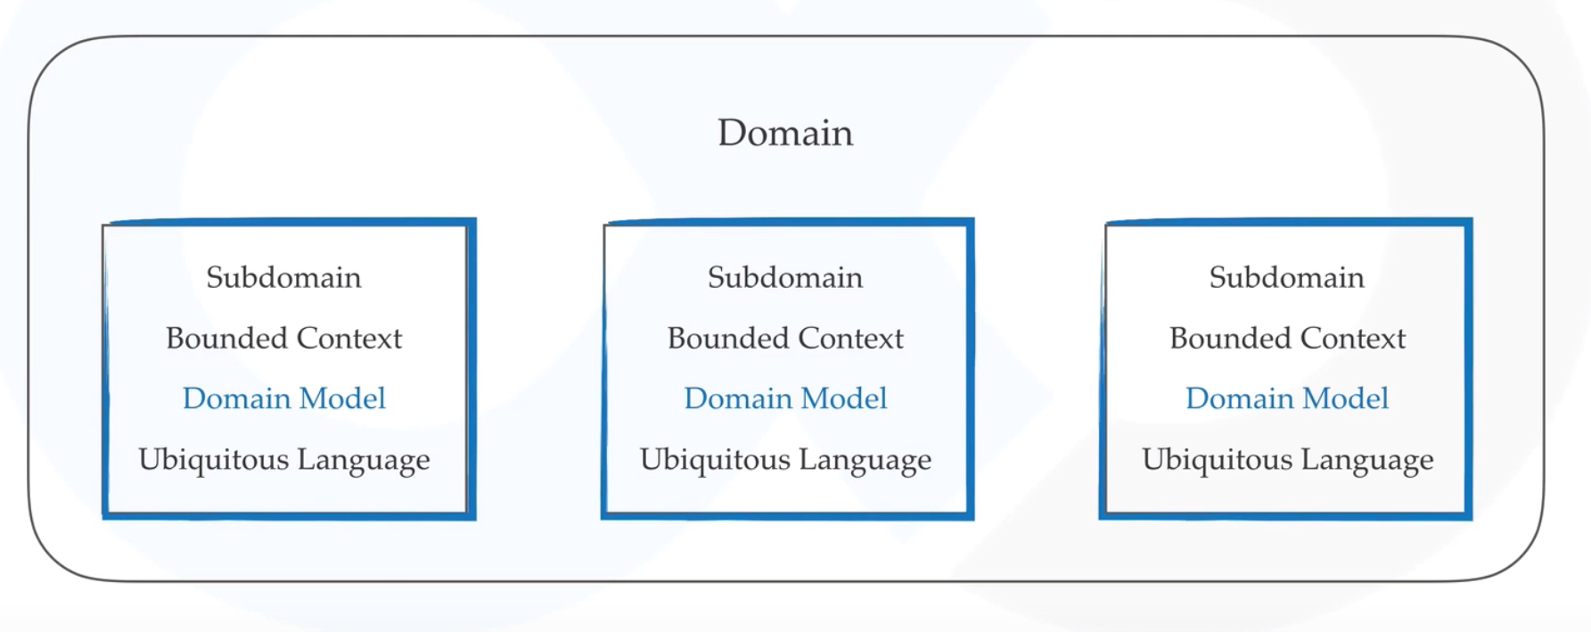

Slide 34
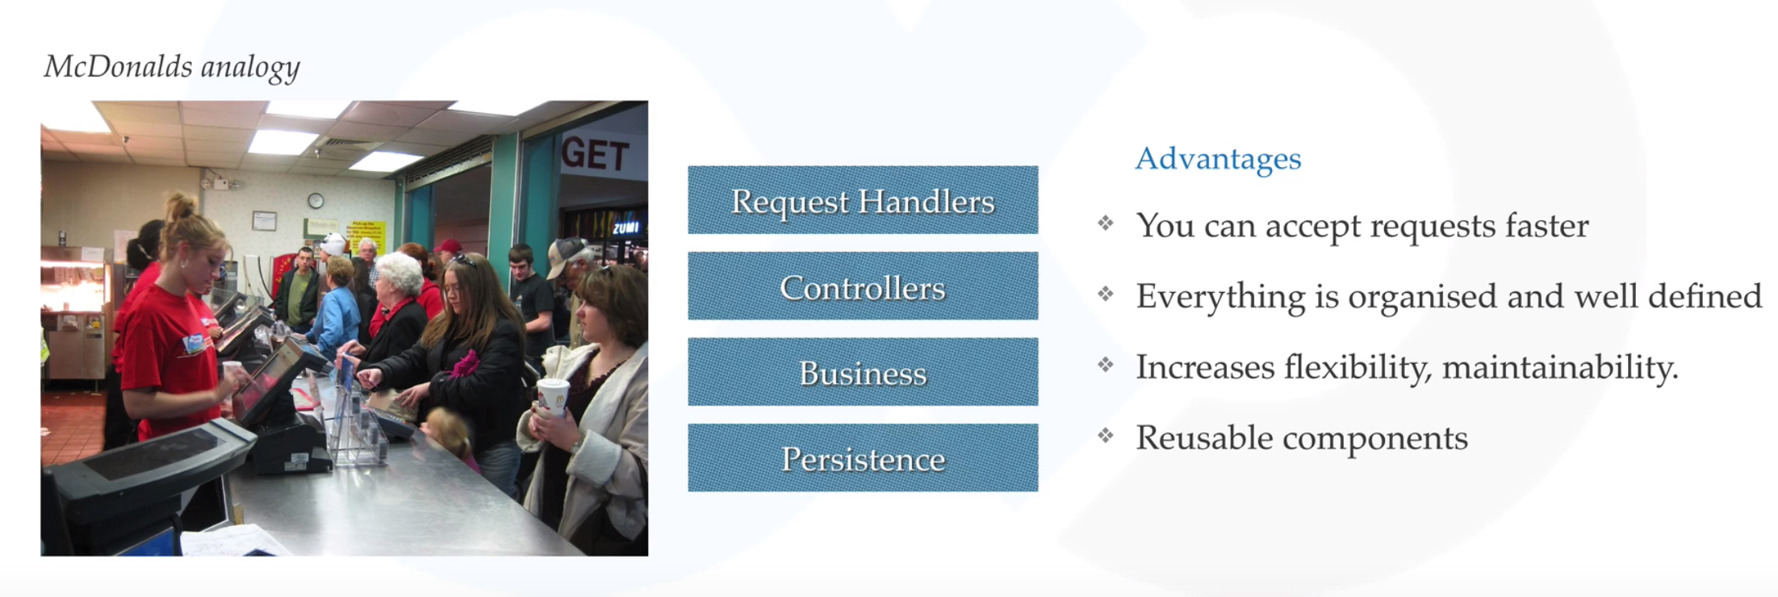

Slide 35
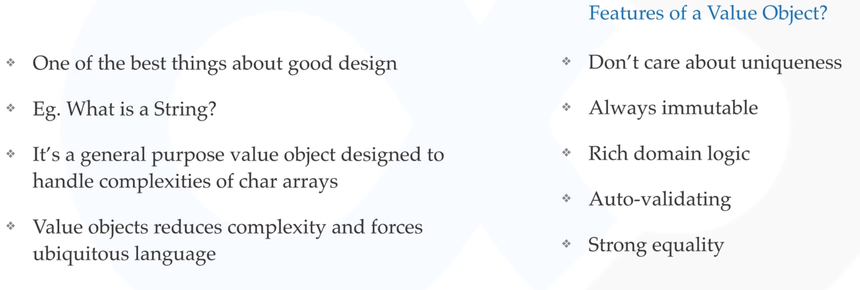

Slide 36
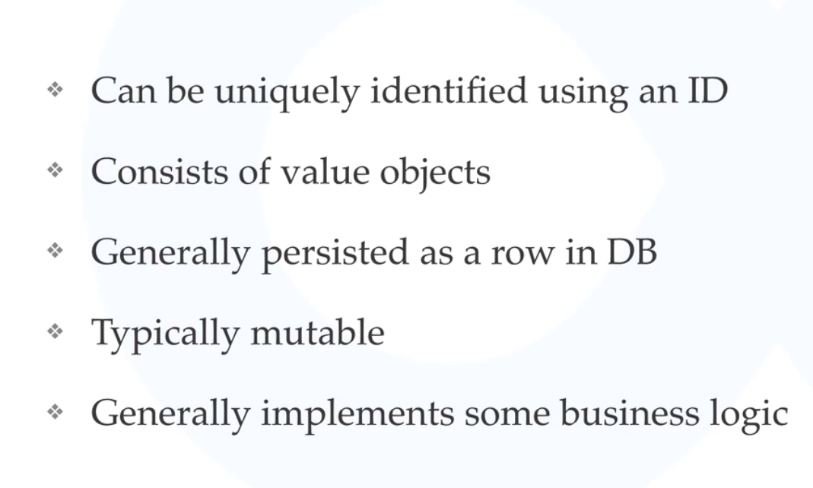

Slide 37
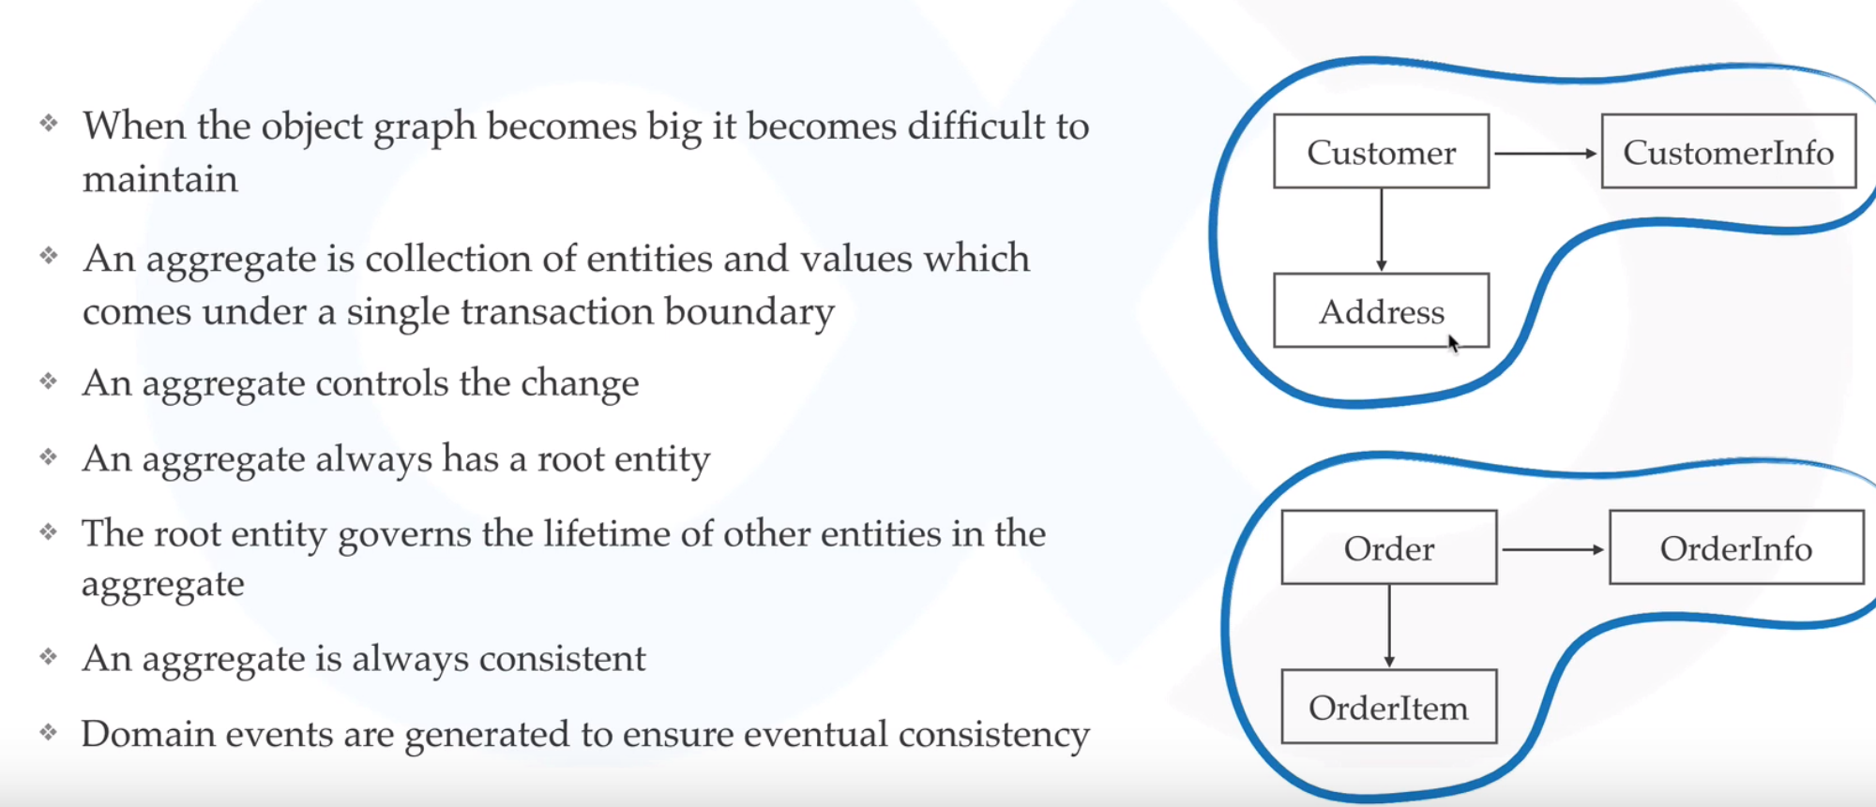

Slide 38
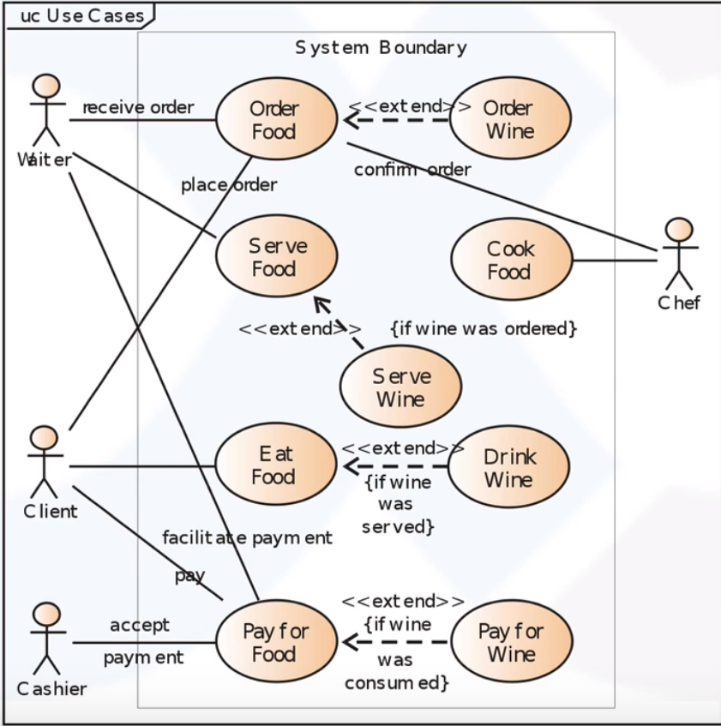

Slide 39
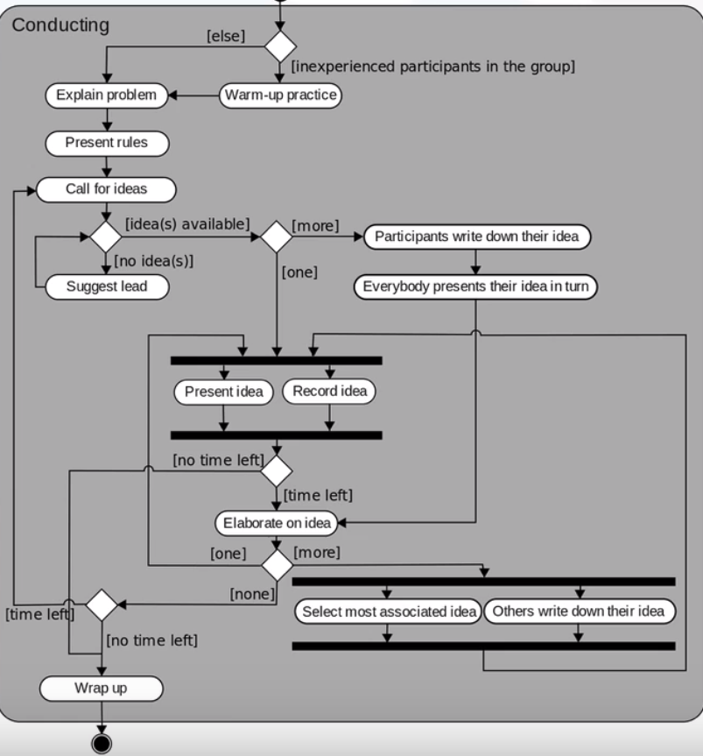

Slide 40
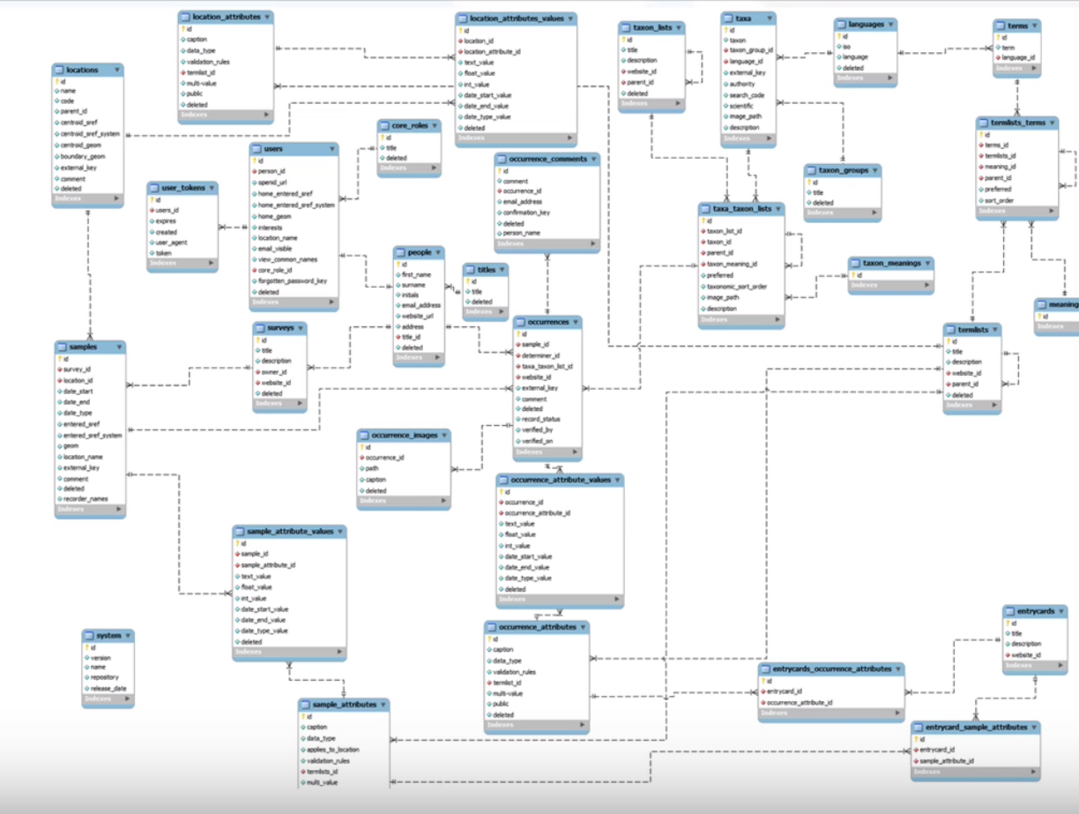

Slide 41
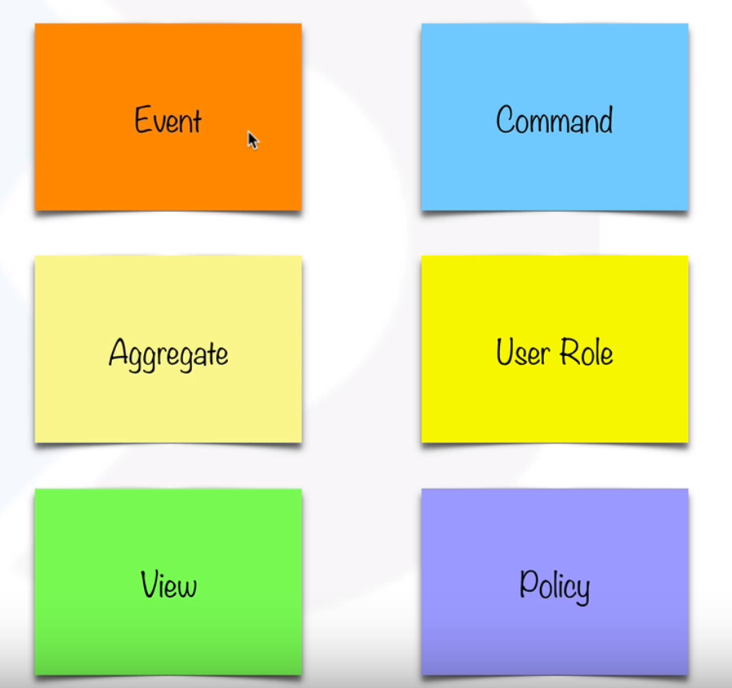

Slide 42
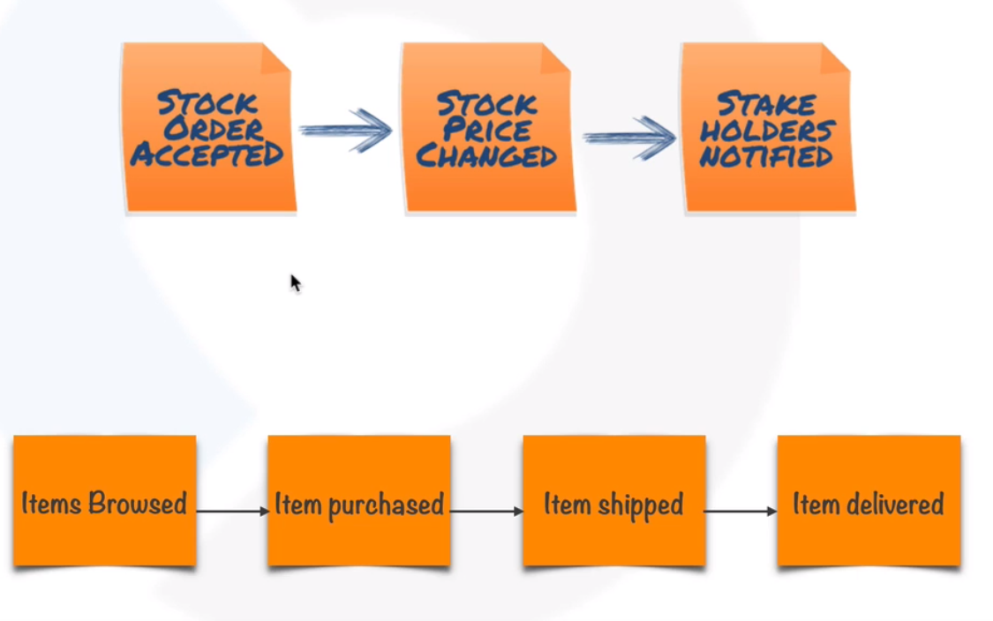

Slide 43
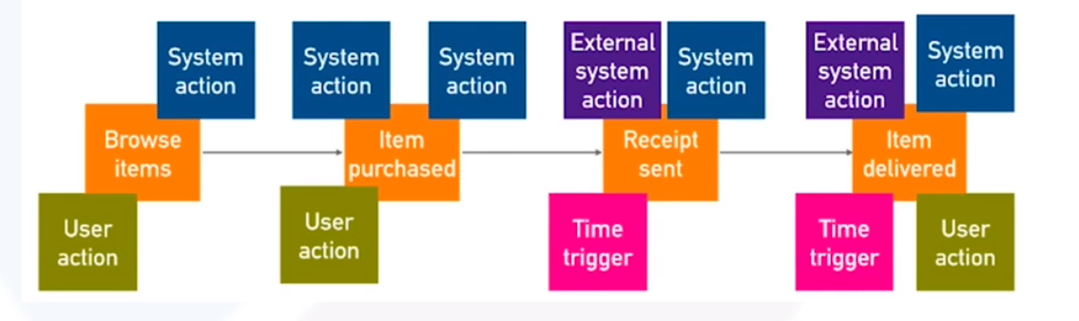

Slide 44
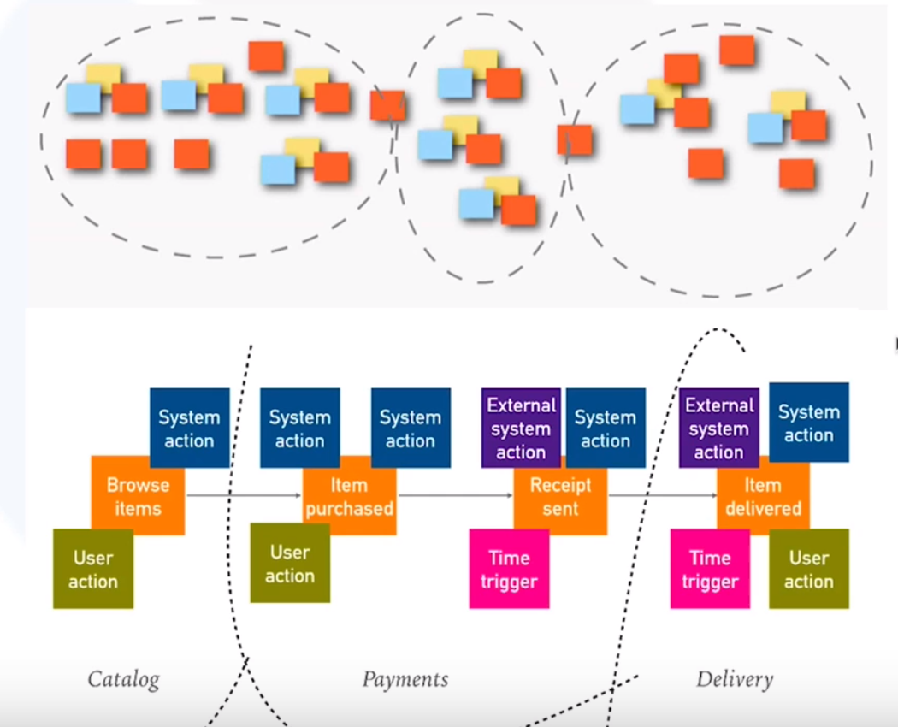

Slide 45
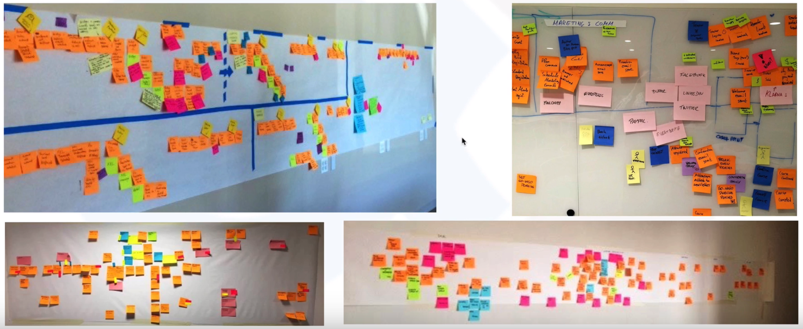

Slide 46
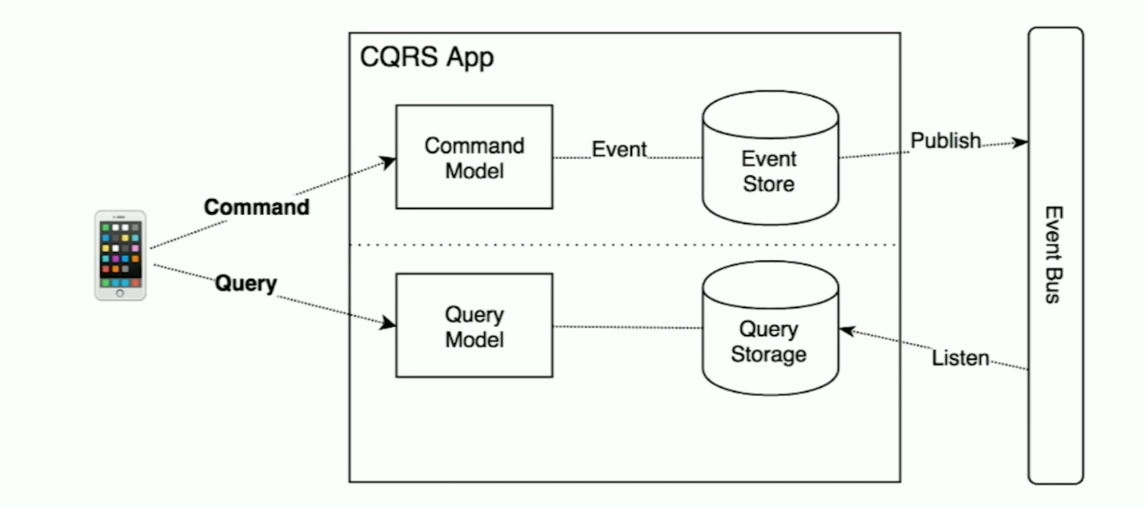

Slide 47
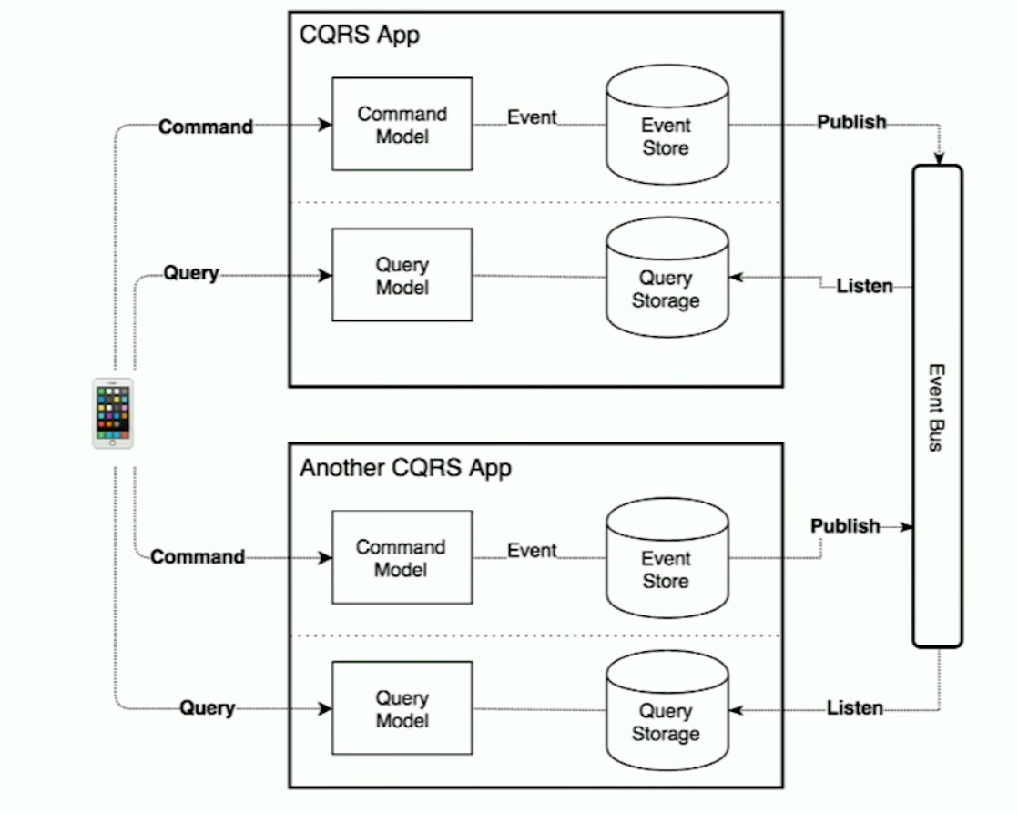

Slide 48
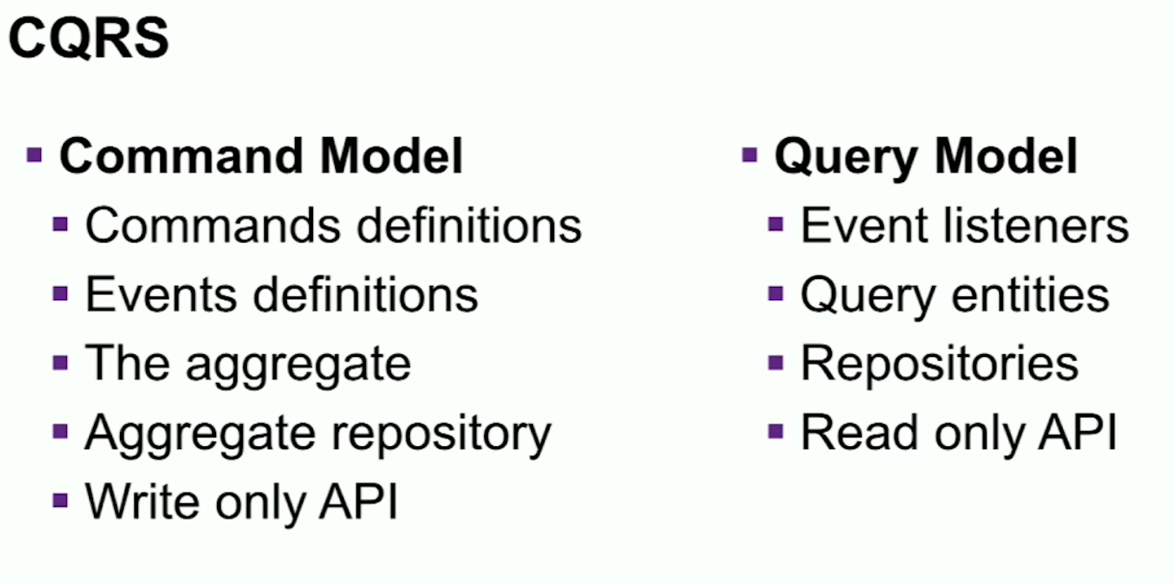

Slide 49
